Slide 1
Huffman Coding:
An Application of Binary Trees and Priority Queues
A Mini Project by :-
>Varun N Rao
>Varun L Pai
>Sunil Pai G

Slide 2
ABOUT HUFFMAN CODING....
Proposed by Dr. David A. Huffman in 1952
  “A Method for the Construction of Minimum Redundancy Codes”
It is a technique used to compress files for transmission
Applicable to many forms of data
  Our example: text files

Slide 3
THE BASIC ALGORITHM......
Not all characters occur with the same frequency!
Yet all characters are allocated the same amount of space in normal storage.
  1 char = 1 byte, be it e or x
Uses statistical coding
  more frequently used symbols have shorter code words

Slide 4
Code word lengths are no longer fixed like ASCII.
Code word lengths vary and will be shorter for the more frequently used characters.

Slide 5
The (Real) Basic Algorithm
1. Scan text to be compressed and tally occurrence of all characters.
2. Sort or prioritize characters based on number of occurrences in text using Pririty queue.
3. Build Huffman code tree based on prioritized list.
4. Perform a traversal of tree to determine all code words.
5. Scan text again and create new file using the Huffman codes.

Slide 6
STEP 1:Scan text and tally occurence
Consider the following short text:
Eerie eyes seen near lake.
Count up the occurrences of all characters in the text
E e r i space
y s n a r l k .

Slide 7
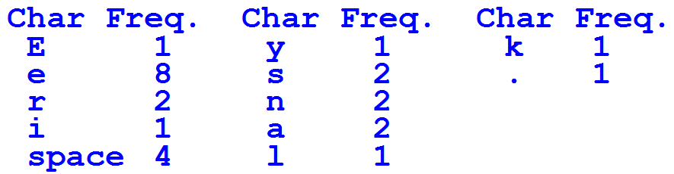
Counting characters....

Slide 8
STEP 2:Create Nodes and Insert in Priority Queue
Create binary tree nodes with character and frequency of each character
Place nodes in a priority queue
  The lower the occurrence, the higher the priority in the queue

Slide 9
STEP 3: Building A Tree
The Priority queue after inserting all nodes
Left and Right fields of all nodes in the queue are null(not shown)
E
1
i
1
y
1
l
1
k
1
.
1
r
2
s
2
n
2
a
2
sp
4
e
8

Slide 10
While priority queue contains two or more nodes
  Create new node
  Dequeue node and make it left child node.
  Dequeue next node and make it right child node.
  Frequency of new node equals sum of frequency of left and right children
  Enqueue new node back into queue

Slide 11
Building Tree.....
E
1
i
1
y
1
l
1
k
1
.
1
r
2
s
2
n
2
a
2
sp
4
e
8

Slide 12
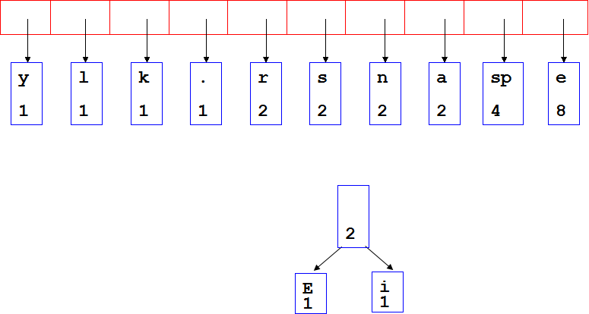
Building Tree....

Slide 13
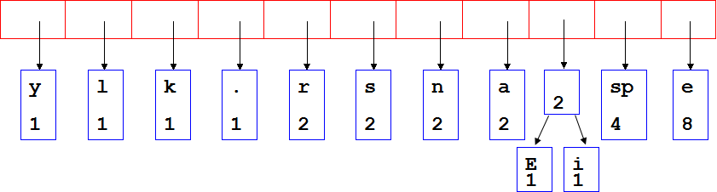
Building Tree....

Slide 14
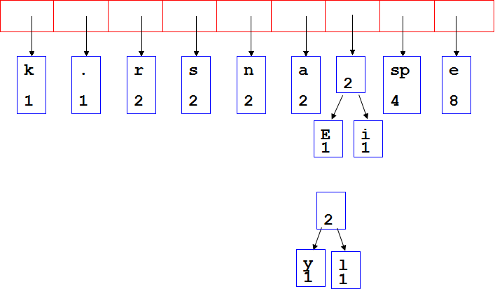
Building Tree....

Slide 15
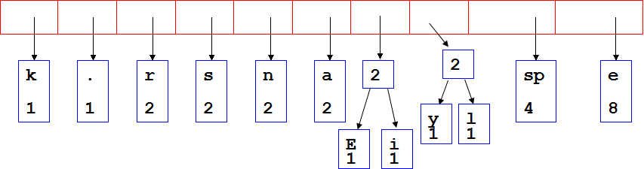
Building Tree....

Slide 16
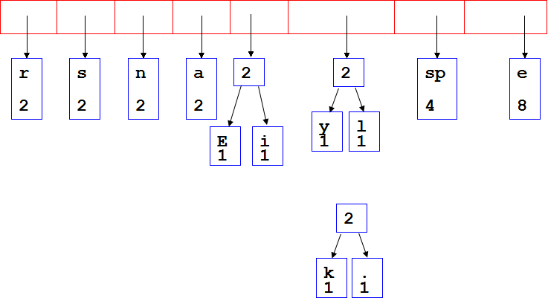
Building Tree....

Slide 17
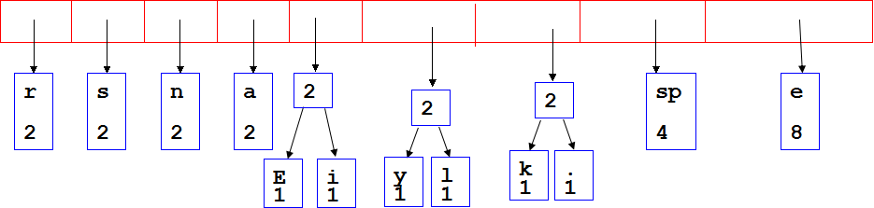
Building Tree....

Slide 18
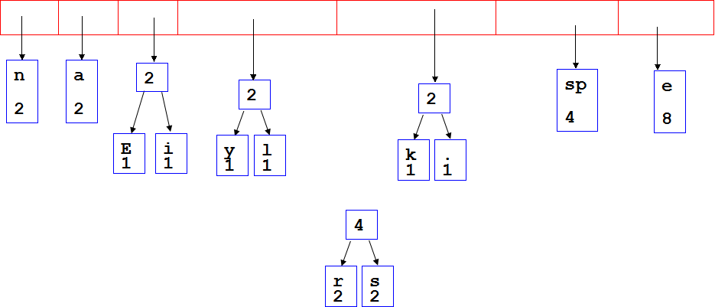
Building Tree....

Slide 19
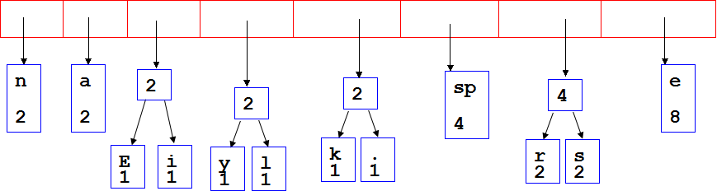
Building Tree....

Slide 20
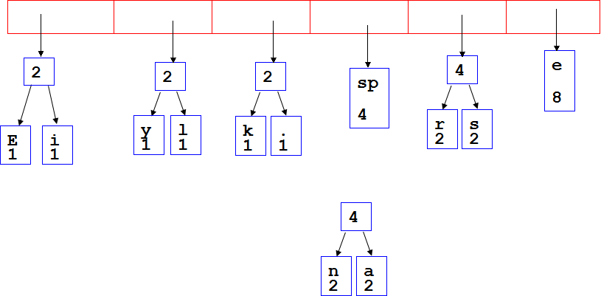
Building Tree....

Slide 21
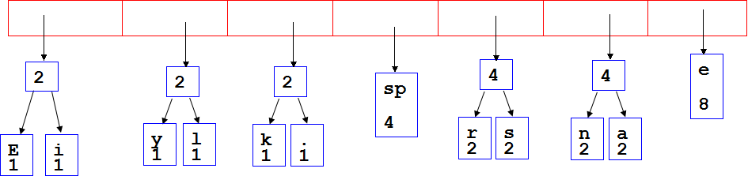
Building Tree....

Slide 22
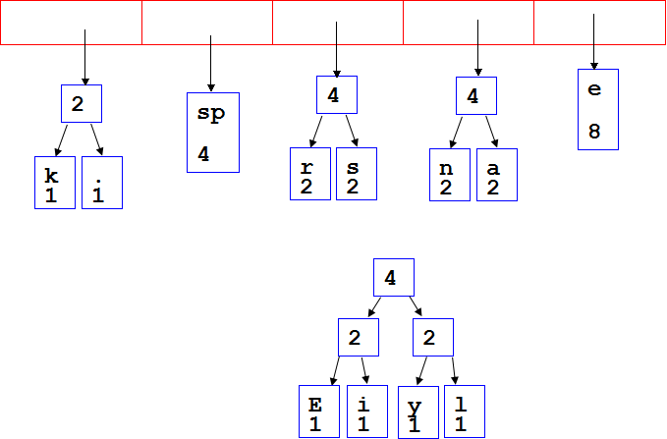
Building Tree....

Slide 23
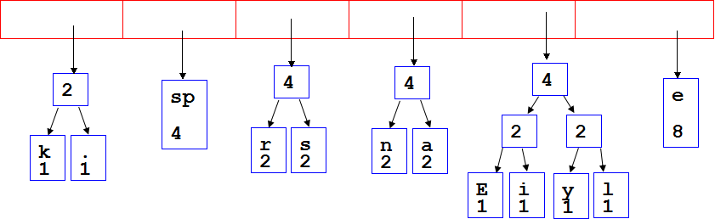
Building Tree....

Slide 24
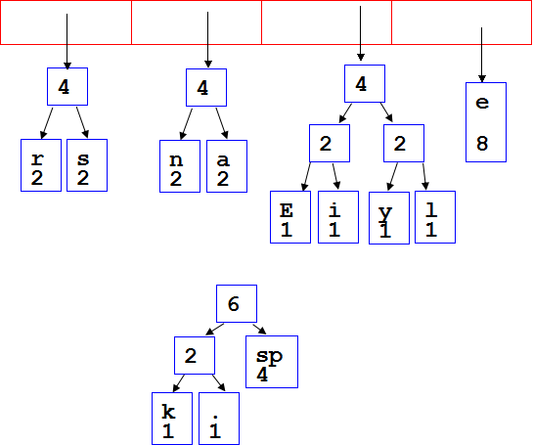
Building Tree....

Slide 25
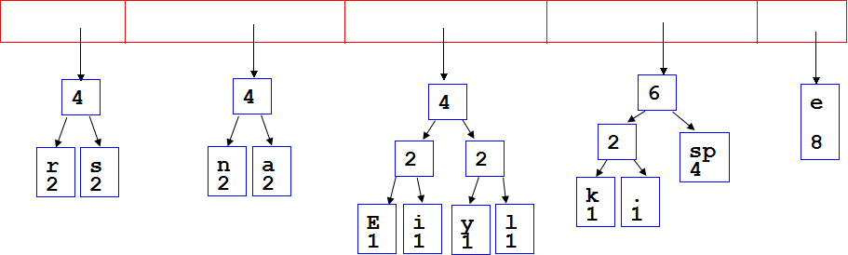
Building Tree....

Slide 26
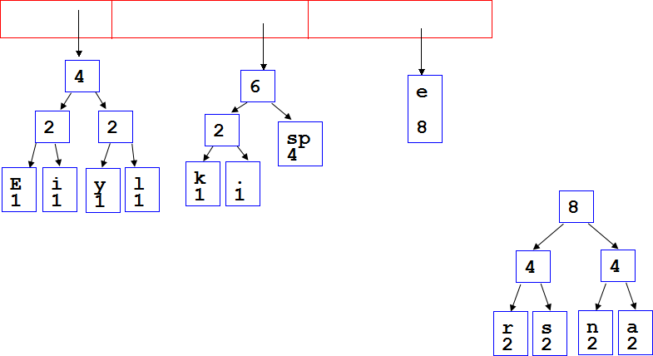
Building Tree....

Slide 27
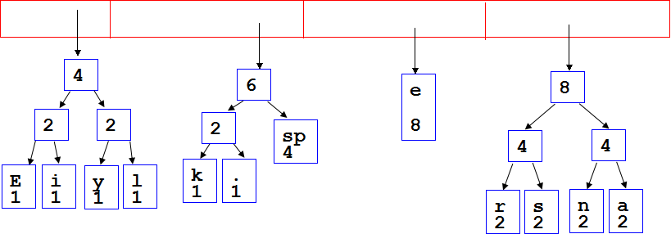
Building Tree....

Slide 28
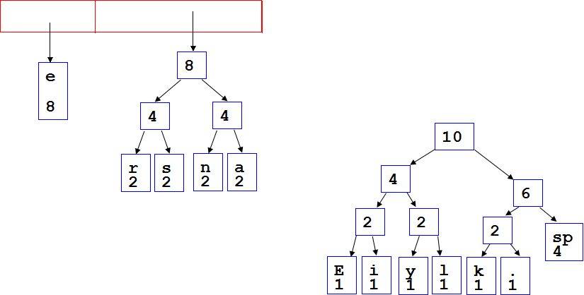
Building Tree....

Slide 29
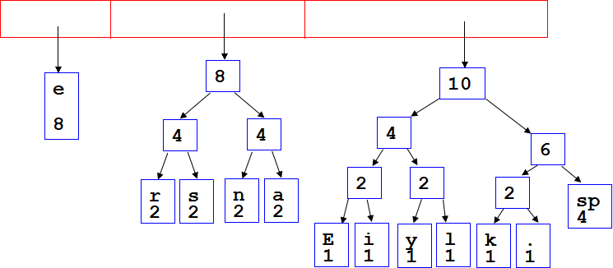
Building Tree....

Slide 30
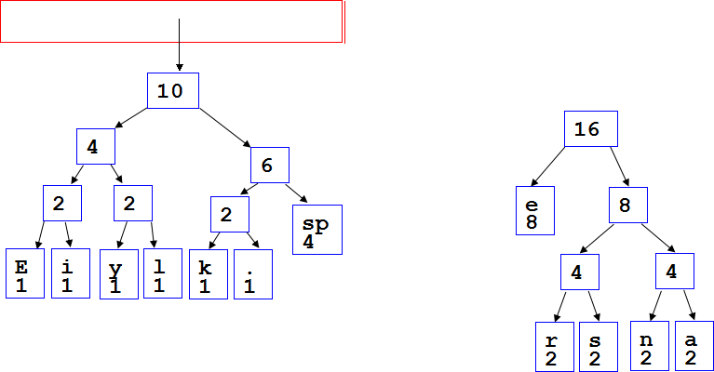
Building Tree....

Slide 31
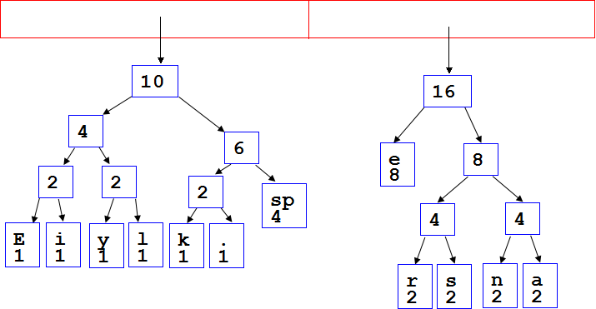
Building Tree....

Slide 32
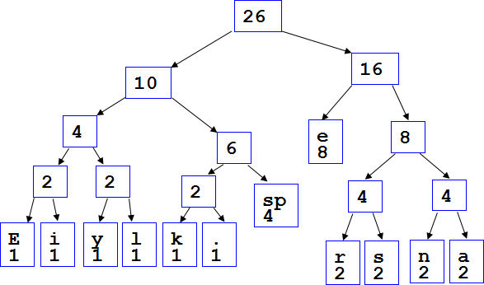
Building Tree....

Slide 33
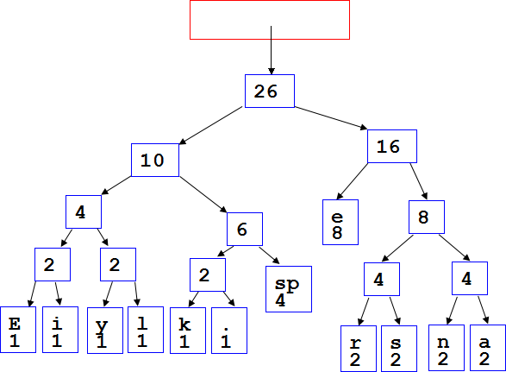
Building Tree....
After enqueueing this node there is only one node left in priority queue.

Slide 34
>Dequeue the single node left in the queue.
>This tree contains the new code words for each character.
>Frequency of root node should equal number of characters in text.
26
16
10
4
e
8
8
6
2
2
2
sp
4
4
4
E
1
i
1
y
1
l
1
k
1
.
1
r
2
s
2
n
2
a
2
Eerie eyes seen near lake.  26 characters

Slide 35
STEP 4: Encoding the File
Perform a traversal of the tree to obtain new code words
Going left is a 0 going right is a 1
Code word is only completed when a leaf node is reached
26
16
10
4
e
8
8
6
2
2
2
sp
4
4
4
E
1
i
1
y
1
l
1
k
1
.
1
r
2
s
2
n
2
a
2

Slide 36
Traverse Tree for Codes....
Char Code
E 0000
i 0001
y 0010
l 0011
k 0100
. 0101
space 011
e 10
r 1100
s 1101
n 1110
a 1111
26
16
10
4
e
8
8
6
2
2
2
sp
4
4
4
E
1
i
1
y
1
l
1
k
1
.
1
r
2
s
2
n
2
a
2

Slide 37
STEP 5: Encoding the File
Rescan text and encode file using new code words.
Char Code
E 0000
i 0001
y 0010
l 0011
k 0100
. 0101
space 011
e 10
r 1100
s 1101
n 1110
a 1111
Eerie eyes seen near lake.
0000101100000110011100010101101101001111101011111100011001111110100100101

Slide 38
Encoding File
Results
Total:73 bits to encode the text
ASCII would take 8 * 26 = 208 bits
Net Saving:208-73=135 bits
0000101100000110011100010101101101001111101011111100011001111110100100101

Slide 39
Decoding the File
Once receiver has tree it scans incoming bit stream
0 => go left
1 => go right
Do this traversing for each bit till the leaf node is reached.
Get the character from the leaf node and resume the traversing for rest of the bits until the end of the file is reached.
Like this the original file is retrieved
26
16
10
4
e
8
8
6
2
2
2
sp
4
4
4
E
1
i
1
y
1
l
1
k
1
.
1
r
2
s
2
n
2
a
2
10100011011110111101111110000110101

